Slide 1

Welcome Iowa Integration Forum April 15, 2010

Slide 2
Member Testimonial
Steve Henry – Des Moines

Slide 3
Integration Forum Agenda
Welcome
Integration Milestones: Where We Are Today
Top 12 Challenges
Integration Details:
Transition Process Program Integration
Human Resource Operations Customer Feedback
Facilities Materials & Documents
Customer Flow and Processes Assessment & Evaluation
Integrated Services
What’s Next
Questions and Answers
What You Can Do Now

Slide 4
Integration Learning Labs
Des Moines July 2009
Creston July 2009
Dubuque September 2009
Fort Dodge November 2009
Council Bluffs December 2009
Additional Labs:
Newton February 2010
Mason City April 2010
Waterloo May 2010

Slide 5
Milestones
Getting Started

Slide 6
Iowa Law – HF2699
Consultation with Other States
State / Local Partnership in Implementation
Lab Process in Implementation
High Visibility of IWD Director/Deputy Director in all Phases of Implementation
Diversity of Expertise in State Leadership
State Board Setting the Tone for “Leap of Faith” in regard to Performance Measures
New Brand Established – IowaWORKS

Slide 7
Milestones
Transition

Slide 8
Leadership Teams Established
Leadership Initiative Improves Transition Process
Follow-up with Additional Training and Technical Assistance After Launch
Flexibility in Changing as We Learn Through the Labs
Open Consideration of Integration of Other Programs Beyond WIA and Wagner-Peyser
The Mentoring the Occurs when Staff of One Office Visit the Staff of Other Offices
Patience Wins

Slide 9
Milestones
Customer and Staff Impact

Slide 10
Recognizing More Service Opportunities and Customer Needs through Membership Enrollment Statistics
Smooth co-enrollment into WIA programs
Turning Claimants into Job Seekers on Day One
The Challenge of Effectively Serving Multiple Members at Once.
Sharing Customer Feedback, Success Stories, and Promising Practices

Slide 11
Top 12 Things We Learned Through Integration

Slide 12
#12
Knowing more about our customers assists with service delivery.

Slide 13
#11
Not just integrated services – but a Process Improvement.

Slide 14

#10
Integration is clearly different from Collaboration.

Slide 15
#9
Once you lift the rock – you find a lot of SQUIGGLY things underneath!

Slide 16

#8
Technology is a HUGE hurdle.

Slide 17
#7
With Integration we can
Strategically Drive our Resources.

Slide 18
#6
Team Excitement and Engagement GROWS with Comprehension.

Slide 19
#5
It’s not hard to sell – even if it is hard to do.
Everyone wants to do better.

Slide 20

#4
Integration is NOT for the faint of heart.

Slide 21
#3
When our staff spends time with customers, GREAT things happen!

Slide 22
#2
AWESOME STAFF!!!!

Slide 23
#1
Neither floods nor mutant viruses nor
a tanked economy can stop our commitment to improved
customer service.

Slide 24
Member Testimonial
Rosslyn Mulwa - Creston

Slide 25
Overview: Iowa’s Integration Model
3 Purposes: - Demand-Driven, Skill-based - Effective and Efficient - Value-added Impact | 3 Functions/Teams: - Membership - Skill Development - Recruitment & Placement
3 Customer Needs: - Know Skills - Improve Skills - Get Job with Skills | 3 Integrated Inputs/Outputs: - Increased Volume - More with Multiple Services - Higher % Skill Enhancement
3 Methods: - Integrated Customer Pool - Integrated Flow and Services - Integrated Staffing | 3 Integrated Outcomes: - Entered Employment - Labor-Market Retention - Earnings

Slide 26
Integration Functions and Flow

Slide 27
Integration Transition Process

Slide 28
Six Month Transition Process
Month 1: Designate local leadership team
Month 2: Start-up meetings; customer flow and floor planning; draft team assignments; begin regular integration staff meetings; staff training; cross training on program eligibility, services and performance.
Month 3: On-going meetings and communication; finalize team assignments and floor plan; announce team assignments; finalize dates/locations of state sponsored training; on-going staff training (UI internet claims, assessments, résumés, use of DOL and IWD job seeker resources);

Slide 29
6 Month Transition Process, con’t
Month 4: Initial Briefing starts the 8 week countdown; begin daily integration staff meetings; membership team training: begin minor floor plan changes; have membership team visit an integrated center.
Month 5: Skills development team training early in the month; recruitment and placement team training in the middle of the month; have SD and R&P team members visit integrated centers; “soft launch” for current customers; complete floor plan revisions for membership area; team members should practice new functions; detailed review of training received.
Month 6: In the 2 weeks between soft launch and live launch: Floor plan revisions complete; new equipment installed; final review of launch check lists; “dress rehearsal” followed the next day by live launch.

Slide 30
Key transition planning points
Information and Communication
Team building
Practice and preparation
Staff training and cross training
Watch for and share “Light Bulb” moments
Customer comments are excellent
Integrated staff survey results
93% believe integration has been positive for customers
90% felt the transition went pretty well and understood the process
76% are committed to the integrated service model
Most negative comments involve staffing and workload issues

Slide 31
Human Resource Operations

Slide 32
Human Resource Operations
Each leader effectively demonstrates unique requirements of assigned function (Regional Area Coordinator, Site Coordinator, Team Leader).
Leaders function as a team, document team activities and have established team operations.
Salary cost-sharing agreements are executed (if relevant.)
Staff understand and can explain leaders’ functions; and understand difference between functional supervisor and HR supervisor.
Staff are organized into functional teams; operate as a team; and all team members share all team functions

Slide 33
Human Resource Operations
.For those team members that have a unique function not shared by other members, rationale exists to explain this.
Staff on each team can describe their own team function and the functions of other teams.
Staff training on team function is ongoing and hiring reflects integration principles. New staff receive adequate training before delivering any team functions.
Process exists for permanent or temporary staff transfers between teams, and includes adequate training. This includes standards for staff “covering” for other team members.

Slide 34
Facilities & Branding

Slide 35
Integration Premises Policy
Encourage and foster teamwork amongst workforce system staff across program boundaries
Provide more direct and immediate contact with customers and deliver more needed services to more customers.

Slide 36
Key Elements – Premises Policy
Integrated staff members shall work in functional teams, or be assigned a specific set of functions within the model
Staff will work in close physical proximity to other staff performing the same function or on the same team; regardless of program funding stream
Staff will have similar office space as other members providing the same functions on the same team.

Slide 37
Key Elements – Premises Policy
Staff must have open and unhampered access to other staff performing the same function; and customers receiving services under the function.
The staff/team shall be located in the area on a floor plan that is the same area where customers will receive the services of the team/function.

Slide 38
Confidentiality vs. Privacy
Nothing in this policy shall, in any way, alter Iowa’s rules, standards or ethical principles relating to confidentiality of customer data and information.
Furthermore, at the customers’ request, staff will continue to access and use alternative office space if needed to increase the privacy of any transaction.

Slide 39
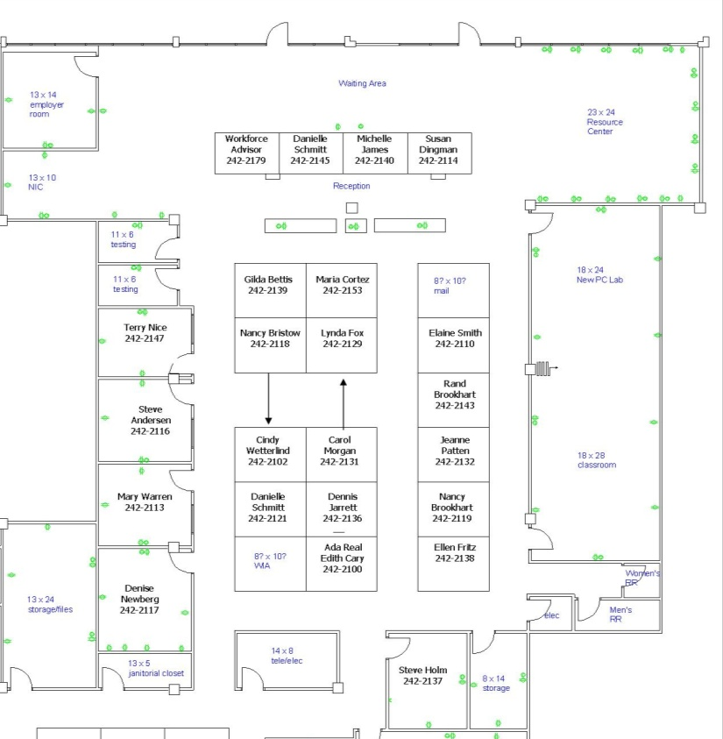
Council Bluffs – Pre-Integration
Front Desk
24 Customer Access Points
19 Staff

Slide 40
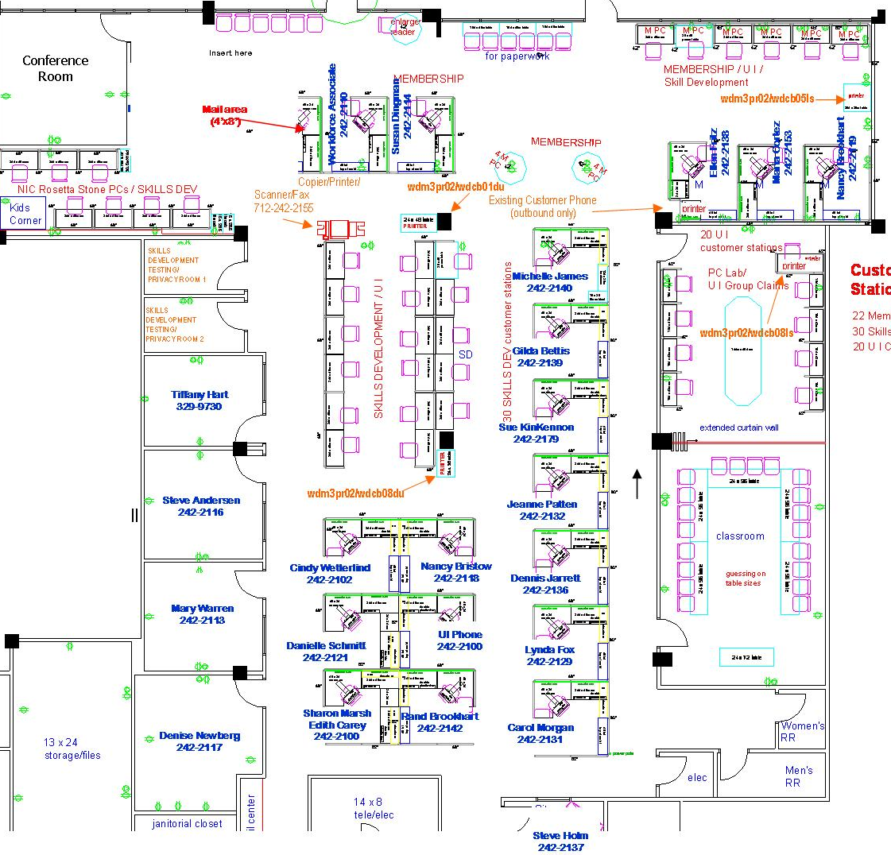
Council Bluffs – Integrated
Welcome/ Greeting area
45 Customer Access Points
19 Staff

Slide 41
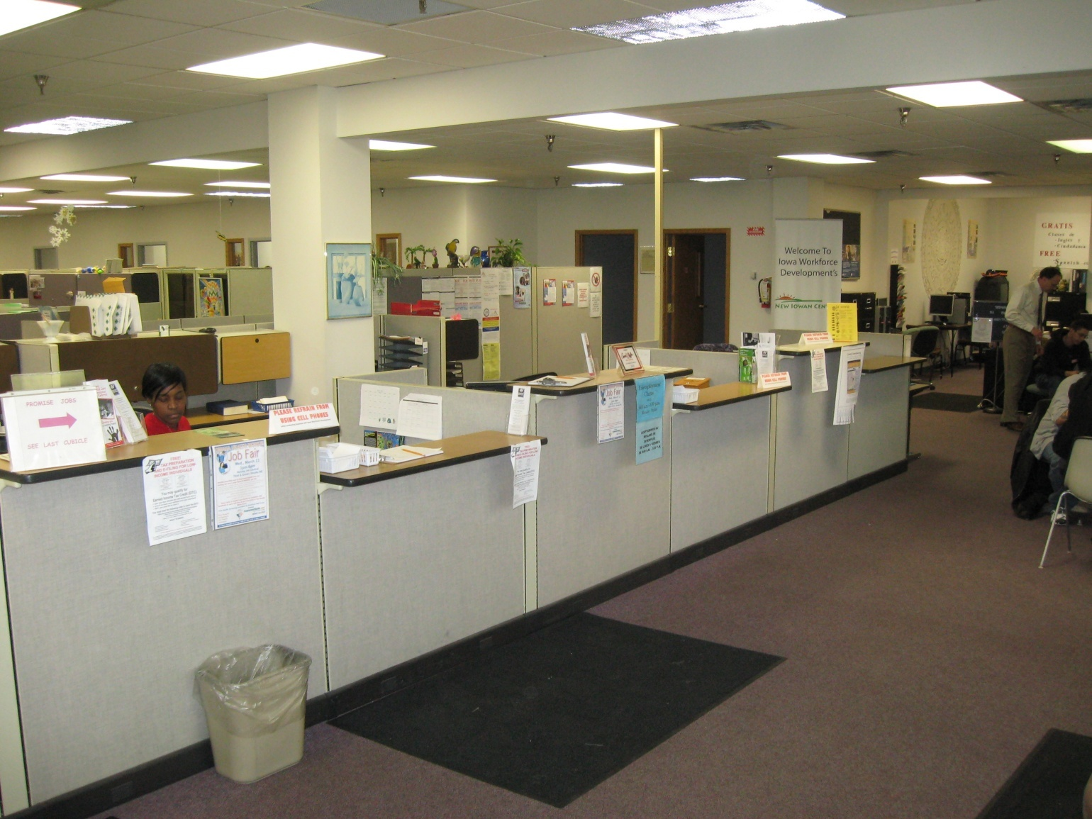
Photos – Council Bluffs - Before

Slide 42

Photos – Council Bluffs - Before

Slide 43
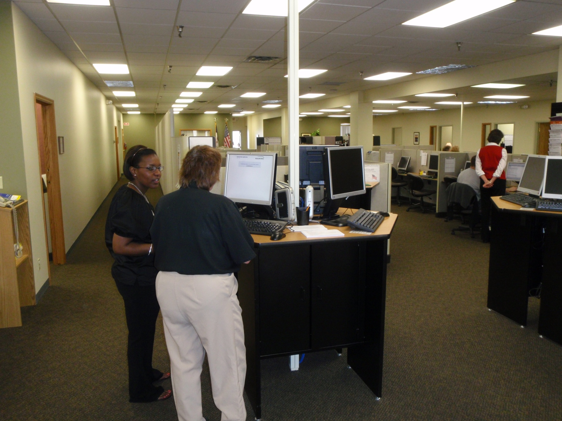
Photos – Council Bluffs - After

Slide 44
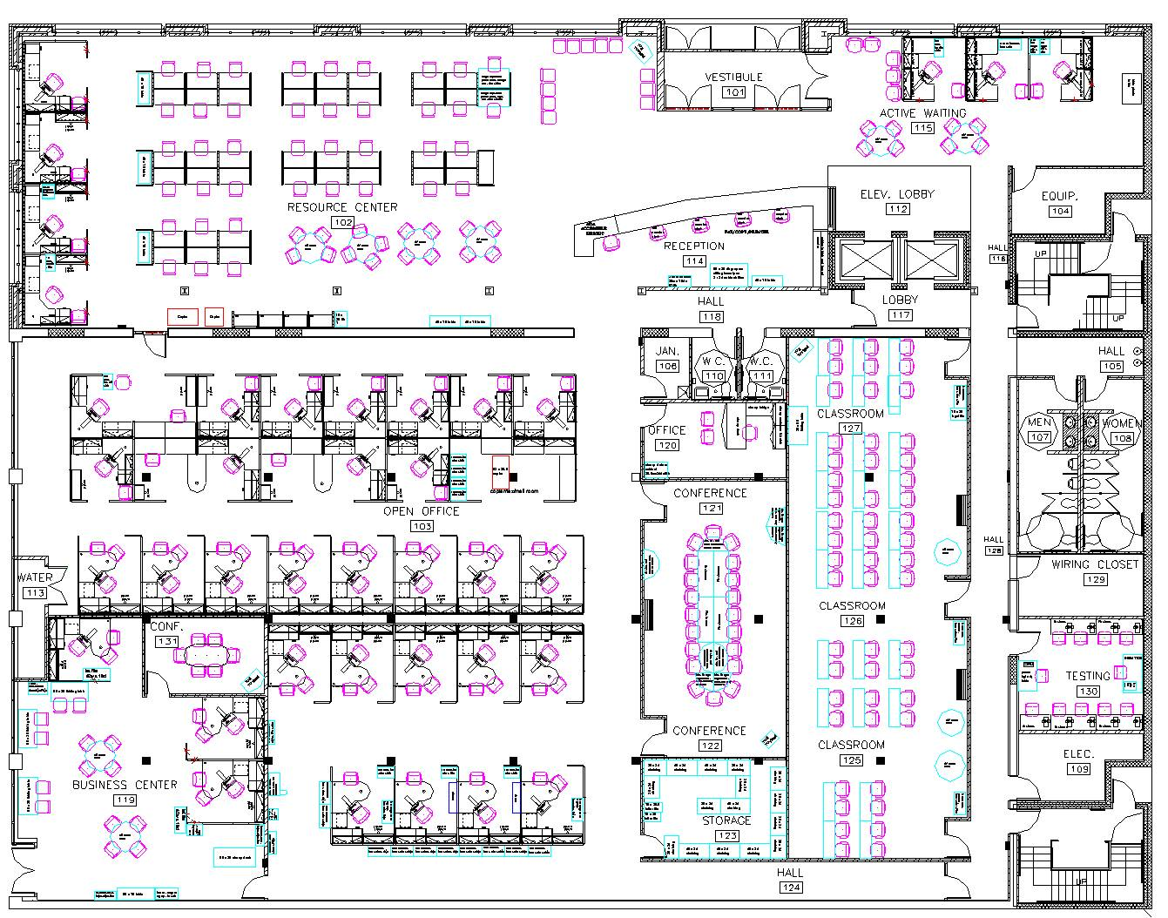
Floor Plan – Des Moines - Before

Slide 45
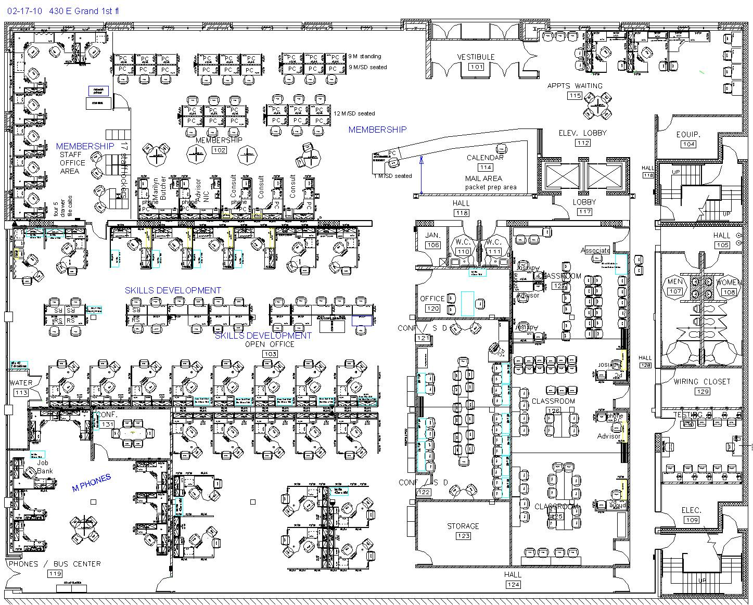
Floor Plan – Des Moines – After

Slide 46
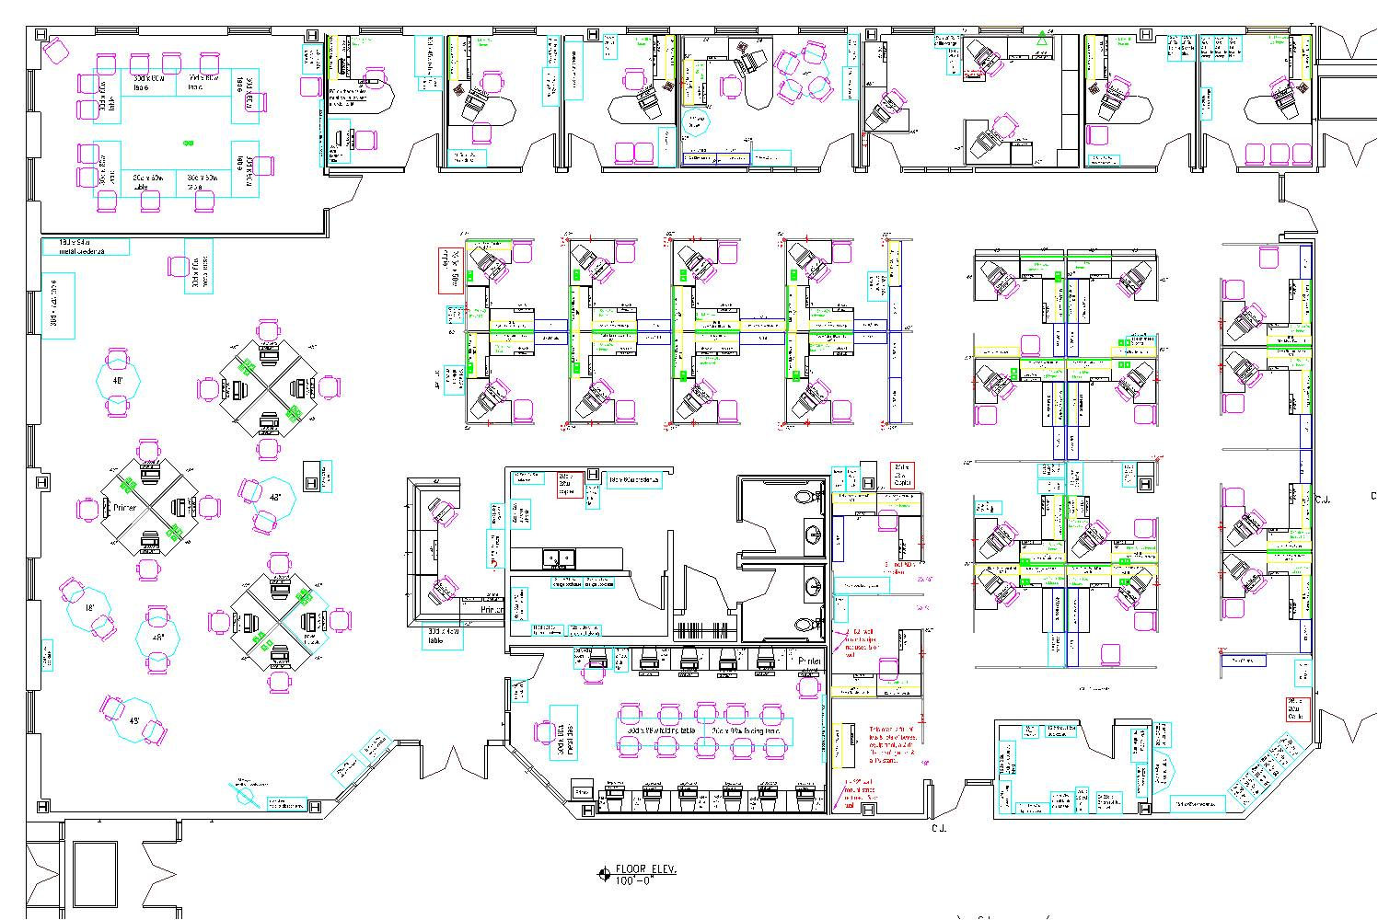
Floor Plan – Fort Dodge - Before

Slide 47
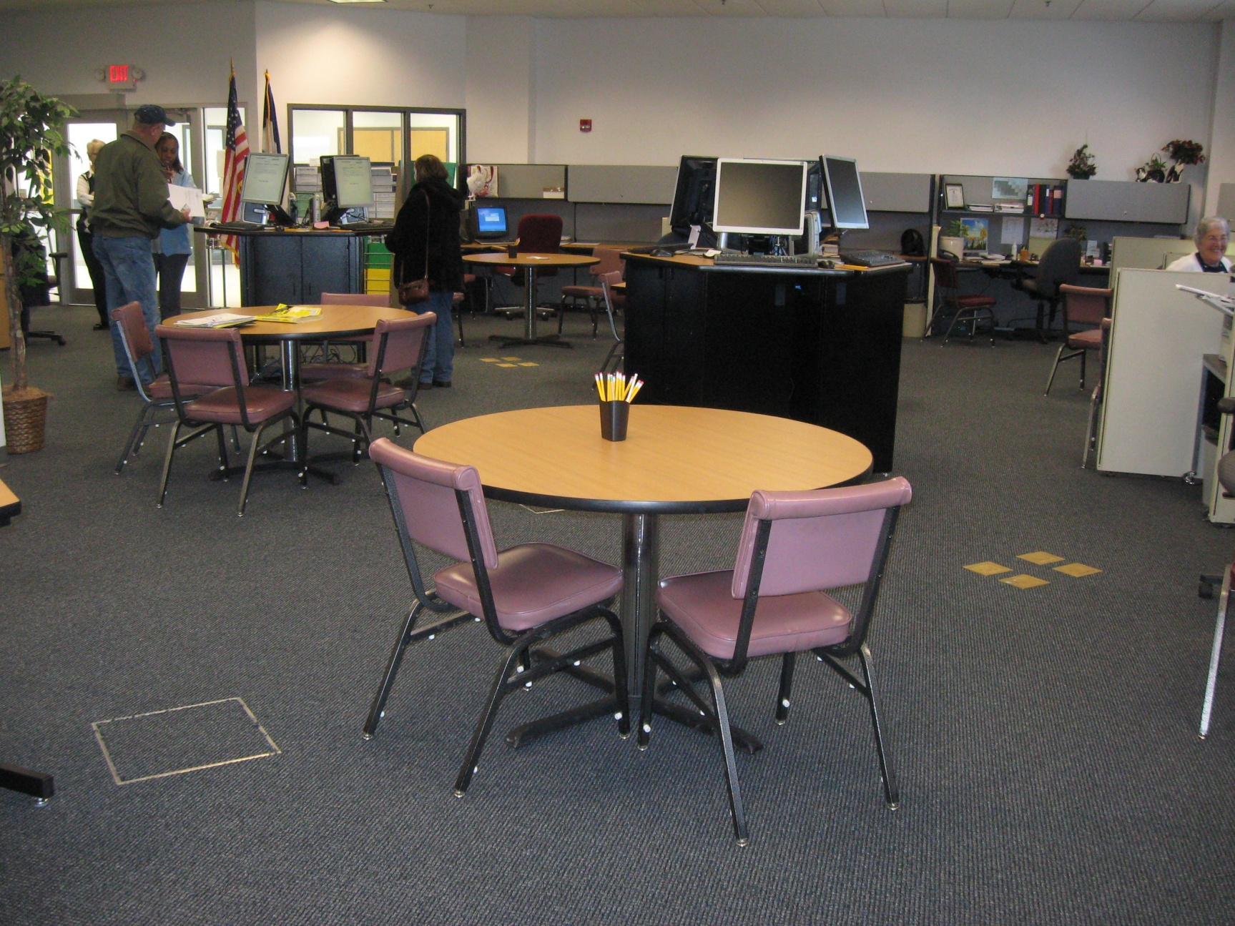
Photos – Fort Dodge - After

Slide 48

Photos – Creston - Before

Slide 49
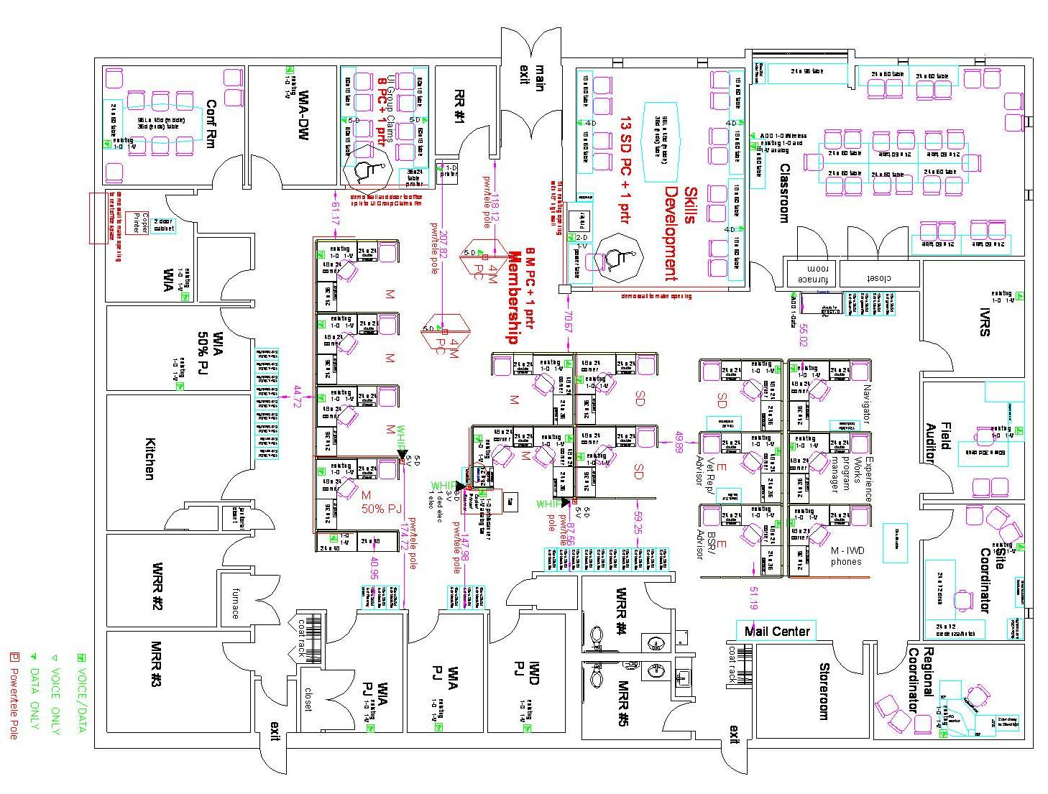
Floor Plan – Creston - After

Slide 50
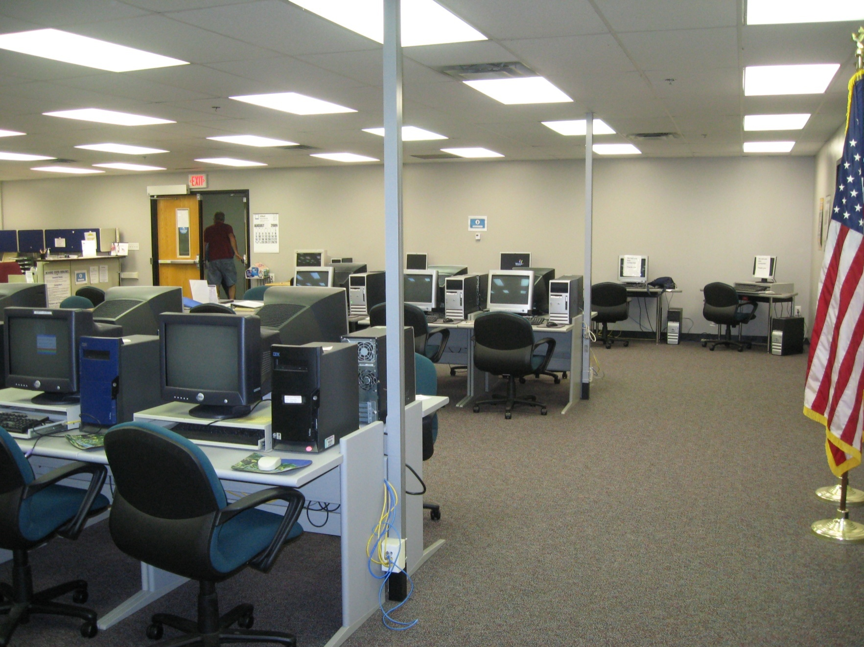
Photos – Newton - Before

Slide 51
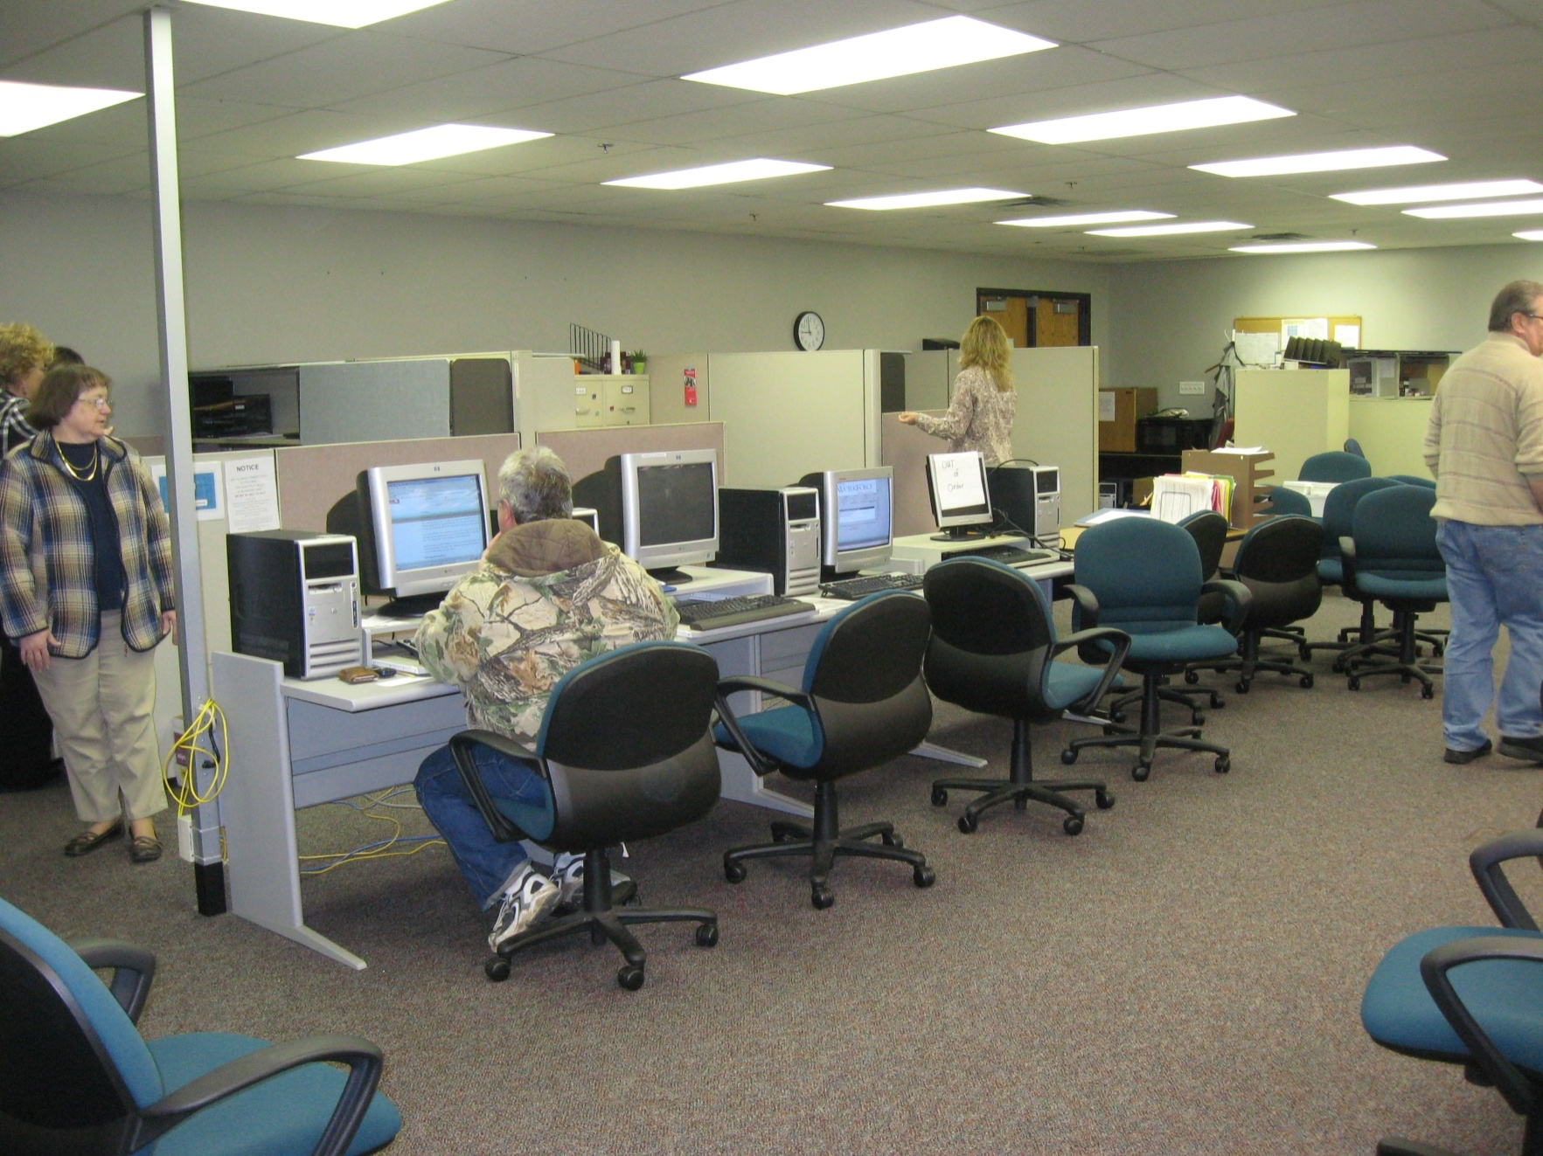
Photos – Newton - After

Slide 52
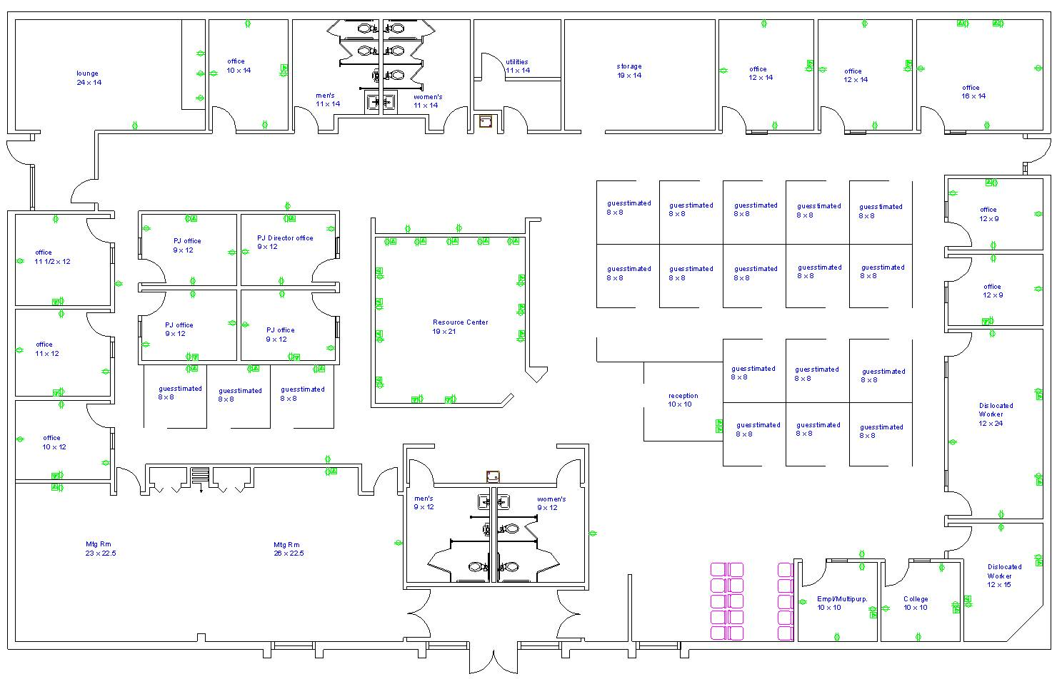
Floor Plan – Dubuque - Before

Slide 53
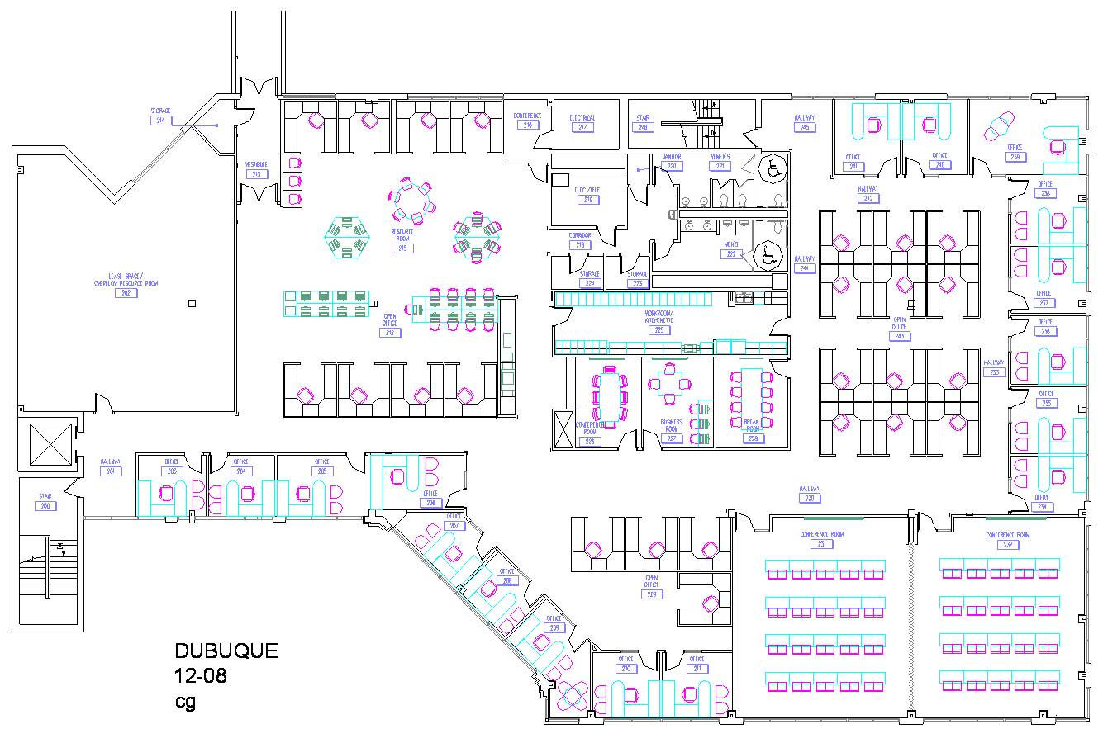
Floor Plan – Dubuque - After

Slide 54
Branding the System
Committee of stakeholders convened to discuss the needs of a unified system brand.
Potential designs were reviewed and discussed.
Voting led to the development of a new brand which allowed regional identification.

Slide 55















Slide 56
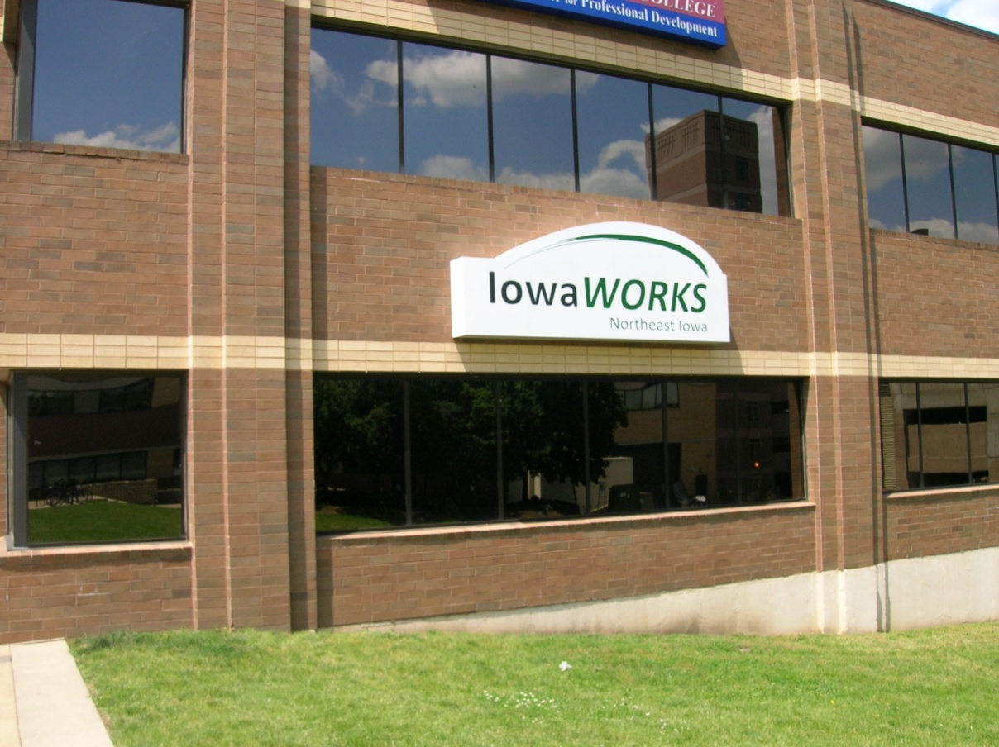
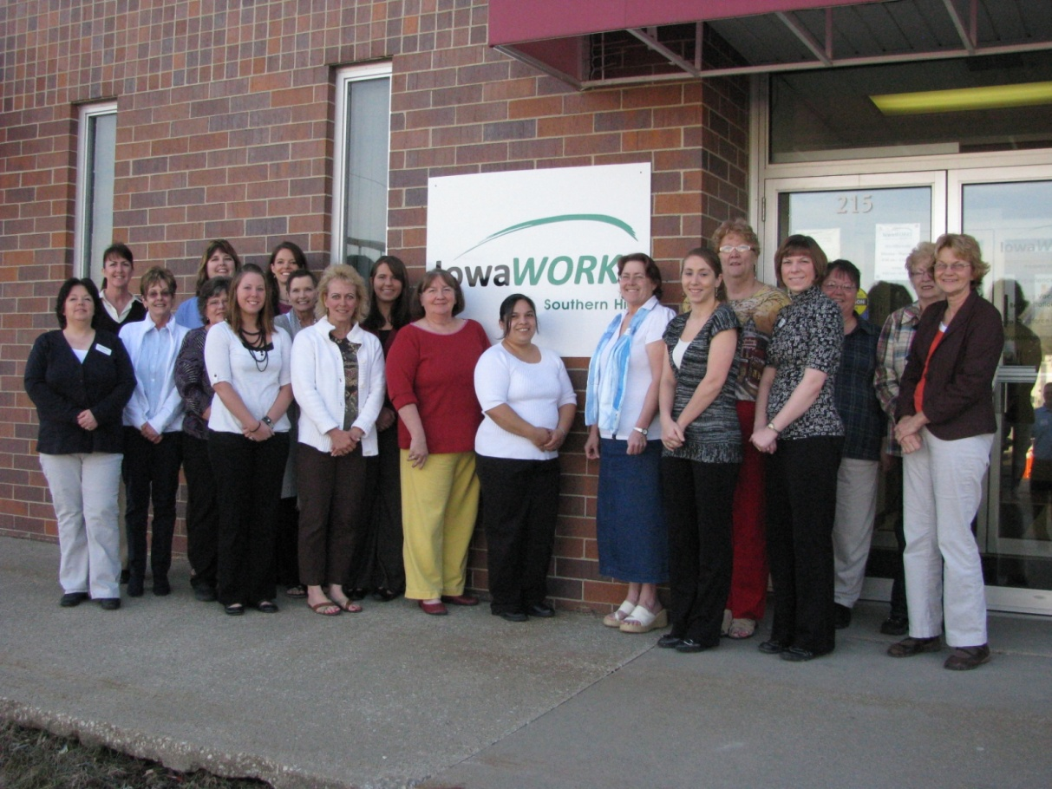
New Signage
Dubuque’ s new signage.
Creston’s new signage and the Integrated staff.

Slide 57
Customer Flow & Processes

Slide 58
Membership Process
Greeting Handoff ; What makes it work
Triage
Cohort Assignment
Membership
Handoff
So what’s different?
Were a learning lab….right?

Slide 59
Skills Development- “The heart of the operation”
The Handoff & get to know
Assessment & initial service plan
Enrollment in training
Documenting service
Handoff to R & P
What is different and what have we learned?

Slide 60
Recruitment and Placement
Bridge between employers and job-ready candidates:
What is different from the traditional business services?
Candidate referral to the team.
Job Order management
Changing the culture

Slide 61
Integrated Services

Slide 62
Services vs Program Delivery
What’s different?
Grouping products and services
Cohort Assignment – pass-off from Membership to Skills with a cohort assignment
Cohort components of services, what are they, how do they differ
Employment plan

Slide 63
Tracking & Buy In!
Tracking methods for services– employment plans, 45 day report and the process, workshop attendance
BI & AI (before integration, after integration)
a. UI, WIA, employment
b. Internal and external customer “buy -in”

Slide 64
Barriers and Challenges
1. What we THOUGHT we needed
floor plan - staffing - customer flow and demand
2. What we really needed and the challenges faced
floor plan – staffing – customer flow and demand
3. Bridges built for system communication
4. RES & REA

Slide 65
Lunch and Q&A

Slide 66
Member Testimonial
Dawn Busse – Ft. Dodge

Slide 67
Program Integration

Slide 68
Program Integration Wagner Peyser Workforce Investment Act—DW/Adult
New in Integrated Services:
Office layout is conducive to providing continuum of services, on demand.
All customers and members are offered the menu of services but only Members attend.
No limit to # enrolled in WIA.
Membership team (IWD,WIA):
assist claimants
greet and begin assessment
Skills Dev.(IWD,WIA,RES,REA)
provide assessment and guidance to determine need for up-skilling.
can create a training plan
can provide case management, (but only for intensive / training)
WIA paper files are streamlined
Recruitment & Placement act as an extension of the employer
Referrals happen everywhere!
Renegotiate Performance
Unique Program Requirements, No change:
UI staff solves UI claims problems.
WIA funded staff approve WIA funded training plans.
WIA funded staff approve expenditures from WIA funds.
WIA funds are limited.
Intensive service trigger
Performance measures.

Slide 69
Program Integration Training Services
Post-Integration-New Definition
TRAINING MENU:
Describe your skills
Resume/application
Prove-it
Interview with confidence
Mock interviews
Basic computers
Basic math for business
How to keep a job
Basic spelling
GED tutoring
Customer Service
= members are more employable, plus
OJT + IST + SEC
CUS + WEP
ENT + RBS
Pre-Integration-TRAINING MENU
By WIA Handbook definition:
OJT
IST
CUS
WEP
ENT
RBS
SEC
= those who succeed are more employable

Slide 70
Program Integration
Results are Worth It!
Integrated staff can use their strengths to step into the model
If UI problem claims are handled at the door=less disturbance of other UI staff
Teams=more help for large events
Practice = confidence
WIA processes /files=less time/ paper
Workshop schedule =larger numbers
Bonus: Members are wowed by the menu and content of workshops, can see benefits immediately and staff members draw energy from the immediate positive feedback received from members.
Seamless coverage on other teams
Bonus: Office atmosphere of continuous improvement and requests for more cross-training
Preparing for Integration:
Make team assignments based on staff’s current strengths
Strongly suggest membership team includes strong UI skills
Work together in new teams to develop team trust/strength
Train staff & practice new services, scripts and workshops
Rework WIA process & paper files to streamline
Set up workshop schedule to be ready for numbers 1st week
Begin to cross-train UI/WIA/VET information

Slide 71
Member & Customer Data and Feedback

Slide 72
Know Your Members
Now What?
DISABLED - Work with state staff to develop strategies in conjunction with the Ticket to Work program and the statewide Employment Network (EN).
GED - Work with local community college to facilitate GED tutoring in our service center.

Slide 73
And the Survey Says…Members
July 20, 2009 (Day One) :
“I appreciate all the new services offered. Workers are all so friendly and helpful. Very appreciated.
“Staff is exceptional. Thank You!”
July 22, 2009: “I really like the way you are helping people with more one on one service.”
August 7, 2009: “Everyone was very helpful to a very confused person. ☺”
August 13, 2009: “This is not the unemployment office anymore!”
March 2010:
“Kudos to the presenter for keeping the workshop both informative and yet still casual and enjoyable, Keep up the great work and thank you.”
"I'm taking away from this class how to do a better resume and better way to get myself across.”
“Thank you very much. I had fun while learning these skills. I would appreciate signing up for more classes.”
And on and on it goes ……………..

Slide 74
And the Survey Says…Staff
76 % ……of Integrated Staff are 100% or strongly committed to the Integrated Model.
93% ……..of Integrated Staff believe or strongly believe that Integration has a positive impact on our members.
18 year employee:
“I love coming to work every day, everyone works together which makes this a pleasant place to work. Everyone is willing to help out, wherever they can, so it feels like there is always help and support for a project.”
3 year employee:
“I had the best week ever here! With all of the different classes we are offering, members are eager to learn and want more! That gets me all riled up to keep doing more!”

Slide 75
Materials & Documents

Slide 76
IowaWORKS Integration Policies
Topic | Brief Description
Iowa Integration Policy | Initial document outlining the Integration objectives and model
Functional Chart | Chart showing relationships across the various elements
Functional Descriptions | Itemized descriptions for all functions (leadership and teams) in Integration Model
Functional Management/Supervision | Difference between formal and functional supervision across program lines
Premises Policy | Integration impact on office layout
Membership and Co-enrollment | Objectives, guidelines and policy on co-enrollment into multiple programs
Skills Development | Objectives, guidelines and policy
Recruitment & Placement | Objectives, guidelines and policy

Slide 77
Materials and Documents
Membership Kits---Colored Folders, appropriate Service Plan, Membership Benefits, Resource Guide, Membership Card, Survey
State Level Pieces---Tip Sheets on Resumes, Cover Letters, Interviewing Do’s and Don’ts, Appearance, Interviewing Conduct, Electronic Devices Etiquette, Financial Aid
Locally Created Pieces---Center Services and Partners, Workshops and Classes, Computer Literacy Classes, GED Information, Local Community Resources

Slide 78
Evaluation & Assessment

Slide 79
Local Evaluation and Assessment
Do not underestimate the magnitude of the change – progress needs to be measured in this context.
Determining the extent to which the model is, or is not working
“Backsliding” – many staff members have a tendency to gravitate back to things that are familiar and comfortable
Continuous improvement -- making sure the overall trend is to move forward – overcoming obstacles and challenges

Slide 80
Integration 1.0 Evaluation
State law requires eventual certification of integrated workforce centers
Interim process will assess the degree to which the model has been implemented
Evaluation process will be developed in partnership with state and local leaders
Criteria will include customer flow, integrated services, customer feedback, and facilities

Slide 81
Member Testimonial
Cindy Pearson Cole – Des Moines

Slide 82


What We Are Working on Now?
1

Slide 83


What We Are Working on Now?
1
House File 2699 Goal
Integrating a “One-Stop” center in each remaining 10 IWD regions by Y2012.
April/May 2010 - Mason City & Waterloo
Aug/Sept 2010 - Cedar Rapids & Burlington
Negotiating One-Stop leases - 3 needing co-location of partners (Sioux City, Davenport, Ottumwa) and Marshalltown
Pending: Carroll (co-location) & Spencer

Slide 84





What We Are Working on Now?
Transitioning more partners into Integration.
Special task forces created Spring 2010 to draft policy on how New Iowans, Veterans, Older Workers, WIA Intensive Services, NEG/Nat’l Emergency Grants, & Trade will provide specialized services within model.
Summer 2010 – New Iowans transition.
Collaborating with Older Worker partners to secure maximum match funds.

Slide 85
What We Are Working on Now?
Small Offices....
Local leadership will develop regional needs proposal and present to State.
Centers with highest UI volume, least remodeling, or lease expiration will be first, due to Premise’s One-Stop priority.
State leadership will schedule based on overall state Integration calendar and co-ordinate Premise’s and I.T. requests.
Local leadership will take lead on training.

Slide 86
What We Are Working on Now?
Developing integrated
center post launch training.
For new hires/upcoming retirement replacements.
Major focus on UI claimant recruitment.
Expanded skills workshops - open to all. Attendees aren’t program specific.
Establishment of FLASH staff communication alert for changes.
Pursuing non-English skills assessment tools.

Slide 87

What We Are Working on Now?
Year 2011- 2012 Earmark Appropriation funding request for:
Additional regional trainers.
Enhanced job search software.
Disability job search tools.
Field office/center reconfigurations.
Finalizing Evaluation 1.0.
Employer Recruitment Quit/Discharged pilot – Council Bluffs.

Slide 88
What We Are Working on Now?
Integrating Small Offices
Goal: No Center will be strictly unemployment. All centers regardless of size will offer Iowans skills services on a limited basis – either on-site or in the community.
Trainers will be local or pulled from a rotating regional or state training squad.
Regional One-Stop must be integrated.

Slide 89
Technology and Integration
Three Steps to Move Toward
Technology in Integration

Slide 90
Step One:
Integrate to one common system for tracking services and reporting.
I-WORKS
July1, 2010, is the target date to have everyone converted and trained.

Slide 91
Step Two:
Develop a quick, comprehensive application that indicate eligibility for Core Services.
Membership Screens
Integrated Centers use these screens in the normal flow of services.

Slide 92
Step Three:
Develop tracking form for easy entry of services accessed while building initial job search plan
Employment Express Screen
Career Development Screen
Career Advancement Screen
Screens are actively used
Continue to undergo modification

Slide 93
New Technology
All these changes use Thin Client technology.
Efficient and Cost Effective
Two items waiting to roll-out
“Swipe Cards”
New Resume tool and format

Slide 94
Performance
There are changes in how we view Performance:
Up-skilling everyone one level
Effects on WIA Incentive
Renegotiating Performance
Performance and Time Frame Changes

Slide 95
Initial Center Integration Start-Up Phase
Training, Soft Launch and Live Launch
Philosophy, Policies, Process, Functions
State Leadership
Local Leadership
Resource Teams

Slide 96
Local Training – Local Leadership
Identifying individual staff persons’ duties and knowledge before and after launch
Training plans for functional teams/ individuals
Cross-Training on unique program inforamation
Training for delivery of services (i.e., filing a claim on the internet; using assessment tools; presenting workshops)

Slide 97
Local Training – Local Leadership cont’d
Local Policy and procedures (i.e., for WIA service management)
Schedule detailed reviews and “practice” of the state-sponsored training during integration team meetings

Slide 98
Additional Training Opportunities
Statewide Trainers/Resource Team
Foundational Skills
Soft and Technical Skills
Curriculum based on knowledge of programs offered by IowaWORKS
In specific support of our integrated service delivery system
Workshop components strategically offered
Continuous improvement

Slide 99
Q&A

Slide 100
What Can Centers Do Now?
10 Ways to Prepare for Integration
“Skill Up” the staff. Ensure they can use/understand all the skills tools and services available.
Talk about Integration at staff meetings.
Use the tip sheets.
Cross inform staff on all programs.
Observe/shadow in an integrated center.

Slide 101
What Can Centers Do Now?
10 Ways to Prepare for Integration
Welcome customers to IowaWORKS, not “next ” or point to the computers.
Have staff take a skills assessment test.
Start developing skills workshops.
Develop employer profiles.
Update all materials with IowaWORKS brand.

Slide 102
Thank You
Elisabeth Buck, Director, Iowa Workforce Development
Joseph Walsh, Deputy Director, Iowa Workforce Development
Melanie Arthur, Melanie Arthur Consulting
Mary Warren, IowaWORKS – Loess Hills
Lori Gregory, IowaWORKS – North Central Iowa
Steve Andersen, IowaWORKS – Loess Hills
Mike Wilkinson, IowaWORKS – Central Iowa
Penny Dow, IowaWORKS – Central Iowa
Barb DeVore, IowaWORKS – Southern Hills
Todd Spencer, IowaWORKS – Southern Hills
Sara Messerly, IowaWORKS – North Central Iowa
Dave Leary, IowaWORKS – Northeast Iowa
Mary Lou Woods, Special Projects Coordinator, Iowa Workforce Development
Jeff Chamberlin, Workforce Program Coord., Iowa Workforce Development
Renée Miller, Bureau Chief, Iowa Workforce Development

Slide 103
Thank You
Forum materials are also available electronically at www.iowaworks.org.

